Slide 1
History of IPITA
Ray V. Rajotte, PhD
Founding Member
Treasurer 1993-2011
IPITA
Bernhard J. Hering, MD
Councilor 1999-2003/2007-2011
President 2013-15
IPITA
Updated October 2023

Slide 2
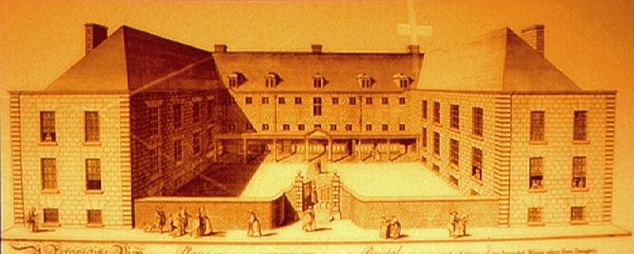
First Recorded Endocrine Pancreas Replacement
The first recorded attempt of endocrine pancreas replacement was in 1894 at the Bristol Royal Infirmary in the United Kingdom. Dr. P. Watson Williams transplanted pieces of sheep pancreas into a young boy who was dying of keto-acidosis.
He reported his results in the British Medical Journal.
Bristol Royal Infirmary

Slide 3
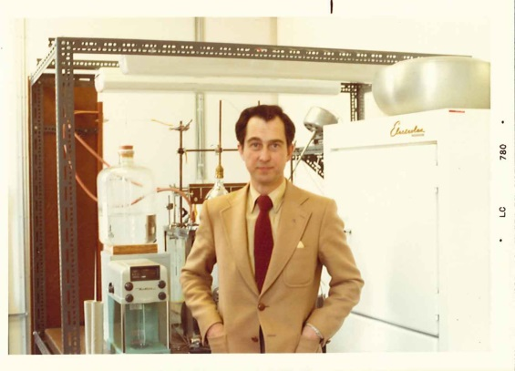
First Recorded Islet Isolation
Seventy years later Dr. Claes Hellerström from Uppsala, Sweden, reported micro-dissecting islets from the rat pancreas for physiological studies.
He published his results in Acta Endocrinologica.
Dr. Claes Hellerström 1964

Slide 4
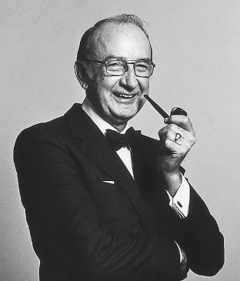
First Successful Experimental Islet Transplant
In 1972, Drs. Walter Ballinger and Paul Lacy from St. Louis, MI, reported in Surgery the transplantation of rat islets into a diabetic rat. For most of us working in the field, this was the start of islet transplantation.
Dr. Paul Lacy

Slide 5
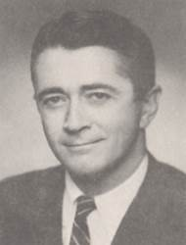
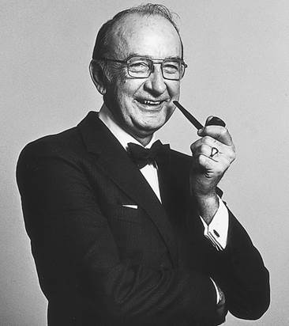
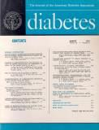
First Meeting on Islet Transplantation
The first meeting on islet transplantation was held in Minnesota in 1974, at the Radisson Hotel. The American Diabetes Association 12th Symposium was organized by Drs. Walter Ballinger and Paul Lacy.
Drs. Walter Ballinger and Paul Lacy
Thumbnail – we can enlarge on Web

Slide 6
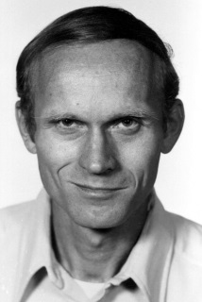
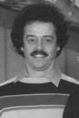
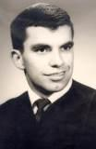
Attendees of First
Meeting on Islet Transplantation
Drs. David Sutherland, David Scharp, and Ray Rajotte attended this meeting and, later in 1991, the three of them would become the founding members of the International Pancreas and Islet Transplant Association (IPITA) in Lyon. In 1993, in Amsterdam they became members of IPITA’s first council.
Dr. David Sutherland
Dr. David Scharp
Dr. Ray Rajotte

Slide 7
Discussion on Forming a Society
on Pancreas and Islet Transplantation
From 1974 to 1988 many meetings were held on islet and pancreas transplantation in Europe, North America, Japan, and Australia. At these meetings, especially in the latter years, there was a lot of discussion on forming a new society on islet and pancreas transplantation. Finally in 1991, discussion focused on a new society that would be for islet transplantation.
Dr. Scharp formed an Organizing Committee which included Drs. Ray Rajotte, Camillo Ricordi, Reinhard Bretzel, Derek Gray, and Yoichi Yasunami. Dr. Scharp suggested the group meet in Lyon at the 3rd International Congress on Pancreatic and Islet Transplantation Symposium and Symposium on Artificial Insulin Delivery Systems in June of 1991. Before the Lyon meeting, Drs. Carl Groth, Orion Hegre, and Tom Mandel agreed to join the Organizing Committee. After the Lyon meeting it was decided to include pancreas transplantation.

Slide 8
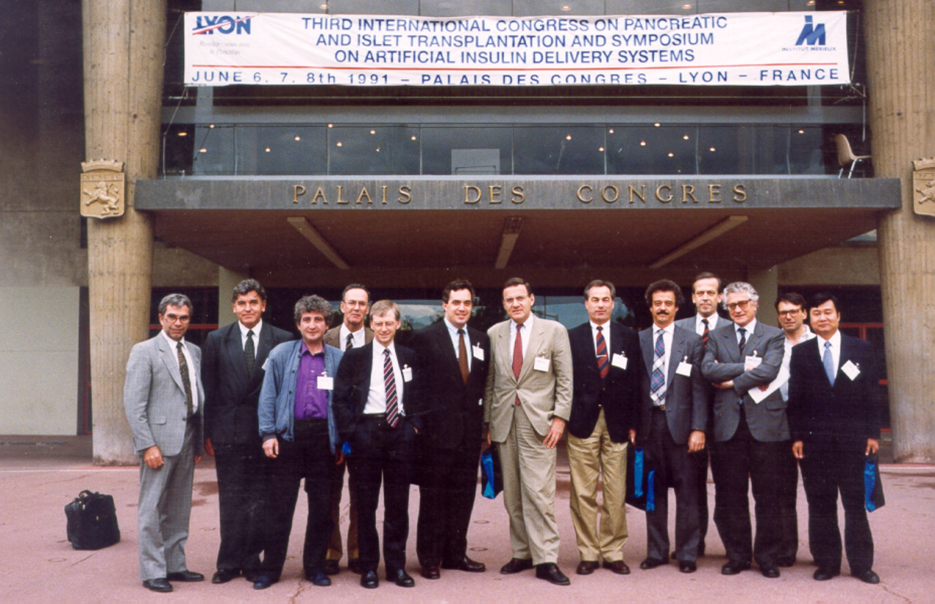
Meeting in Lyon, France in June of 1991
IPITA Organizing Committee

Slide 9
Steps Toward Founding of IPITA
Dr. Scharp was elected Interim Chair but early in 1992 he stepped down due to other commitments. Dr. Scharp suggested Dr. Groth take over as Chair, which he accepted.
The next meeting of the Organizing Committee was held August 19, 1992, in Paris during The Transplantation Society meeting. At that meeting Dr. Groth was elected Interim Chair, Dr. R. van Schilfgaarde (Interim Secretary), and advisory group consisting of Drs. Dubernard, Rajotte, Scharp, and Sutherland.
At the Paris meeting there was strong support that IPITA should be incorporated as an Association in the Transplantation Society. This was supported by Sir Roy Calne President of TTS at the time. It was decided that IPITA be founded at the Amsterdam Congress and the same investigators that were invited to the Paris meeting should be invited to Amsterdam meeting. After the Paris meeting there was still some discussion on what the name of our new should be, but at the 1993 AIDPIT Meeting in Igls, Austria it was decided IPITA should be used.

Slide 10
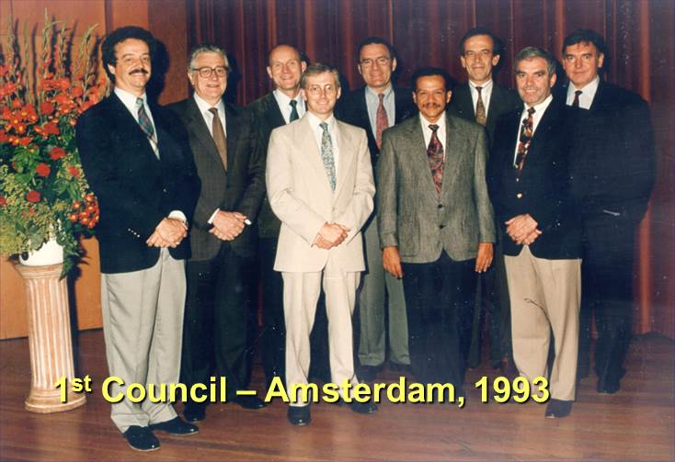
Founding Meeting of IPITA and 1st Council
In May 1993, 100 scientists were invited to a founding meeting of IPITA which was being held in Amsterdam (4th IPITA meeting) and hosted by Dr. R. van Schilfgaarde. Ninety came to the Amsterdam meeting and 60 attended the founding council meeting. The 1st Council was appointed by acclamation.
David Scharp, Guido Pozza, David Sutherland, Derek Gray, Carl-Gustav Groth, Rodolfo Alejandro, Reinout van Schilfgaarde, Ray Rajotte, Jean-Michel Dubernard

Slide 11
IPITA Presidents
1993 - 1995 Carl Gustav Growth, Sweden
1995 - 1997 David E. R. Sutherland, USA
1997 - 1999 Jean-Michel Dubernard, France
1999 - 2001 Camillo Ricordi, USA
2001 - 2002 Reinout van Schilfgaarde, The Netherlands
2002 - 2005 Antonio Secchi, Italy
2005 - 2007 A. M. James Shapiro, Canada
2007 - 2009 Reinhard G. Bretzel, Germany
2009 - 2011 Stephen T. Bartlett, USA
2011 - 2013 Paul R. V. Johnson, UK
2013 -2 015 Bernhard J. Hering, USA
2015 - 2017 Jon S. Odorico, USA
2017 - 2019 Thierry Berney, Switzerland
2019 - 2021 James F. Markmann, USA
2021 – 2023 Raja Kandaswamy, USA

Slide 12
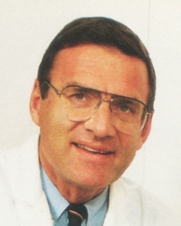
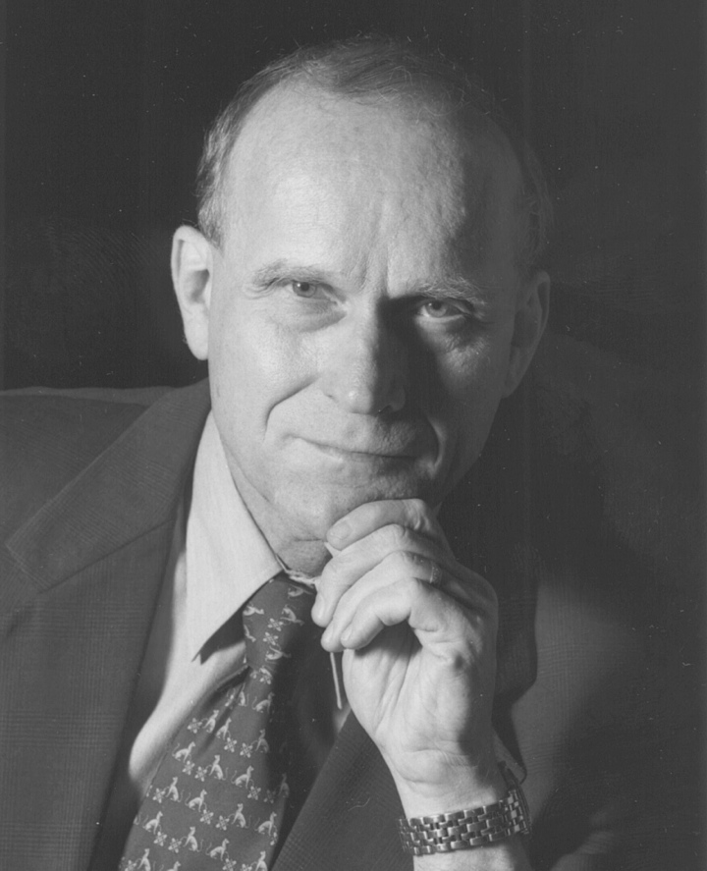
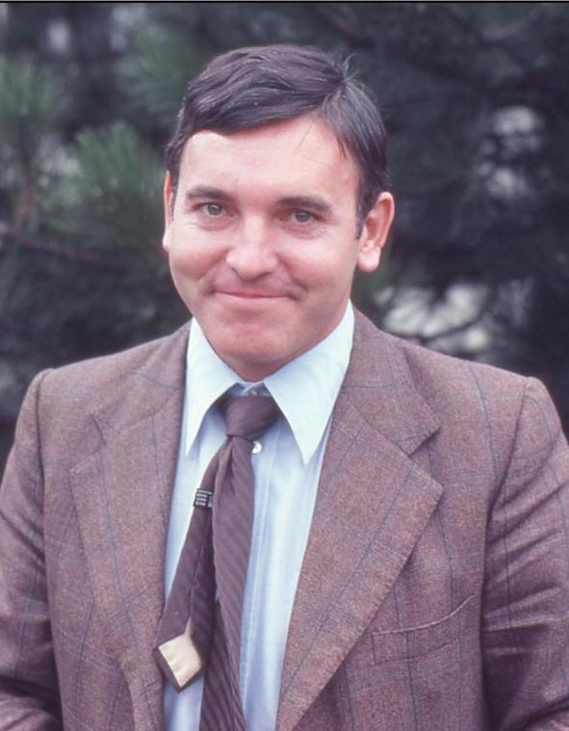
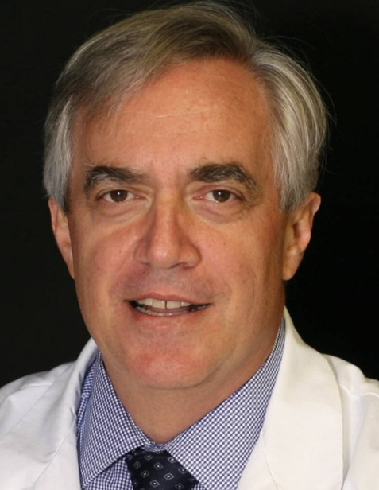
IPITA Presidents No. 1-4
Carl-Gustav Groth
1993-1995
David Sutherland
1995-1997
Jean-Michel Dubernard
1997-1999
Camillo Ricordi
1999-2001

Slide 13
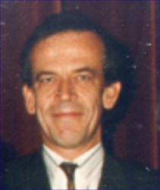
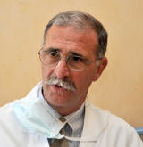
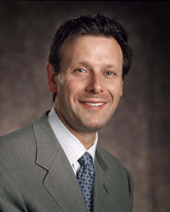
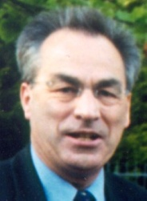
IPITA Presidents No. 5-8
Reinout van Schilfgaarde
2001-2002
Antonio Secchi
2002-2005
A. M. James Shapiro
2005-2007
Reinhard G. Bretzel
2007-2009

Slide 14
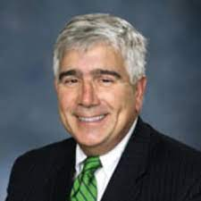
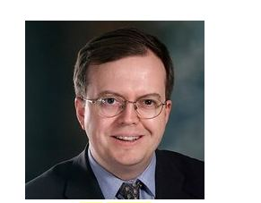
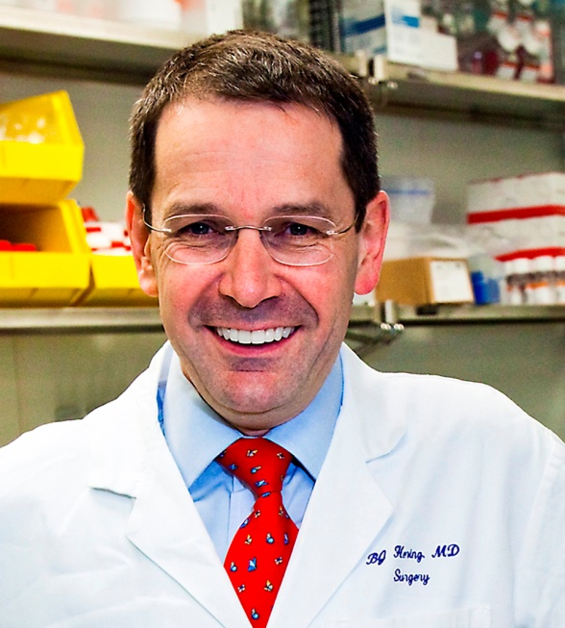
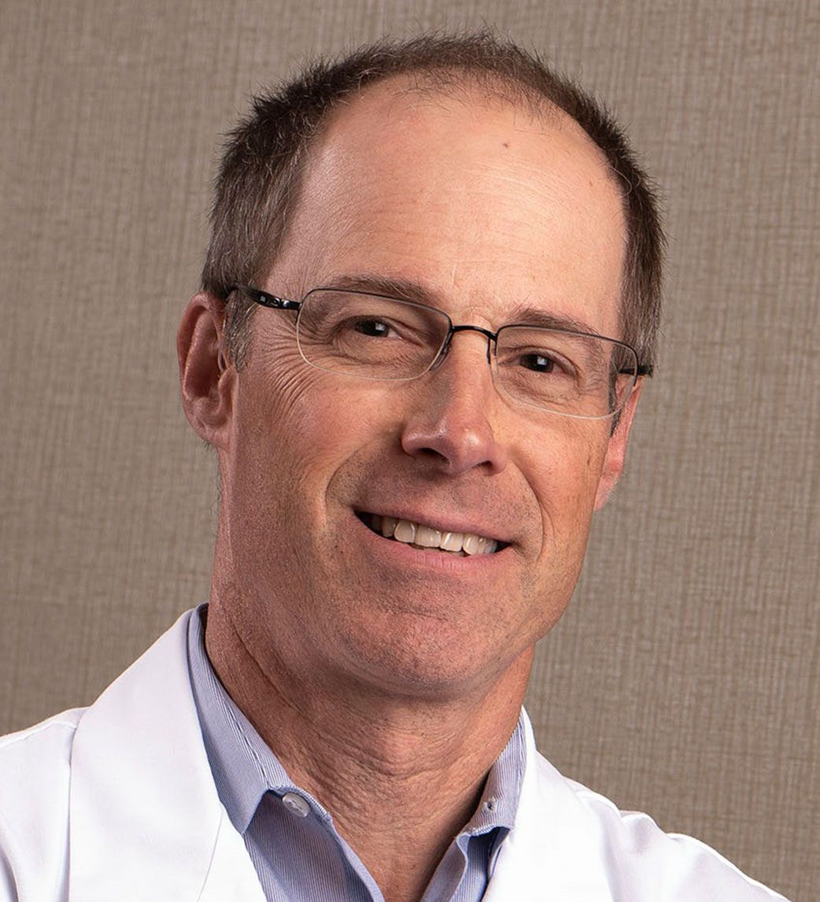
IPITA Presidents No. 9-12
Stephen T. Bartlett
2009-2011
Paul R. V. Johnson
2011-2013
#6-2003
Bernhard J. Hering
2013-2015
Jon S. Odorico
2015-2017

Slide 15
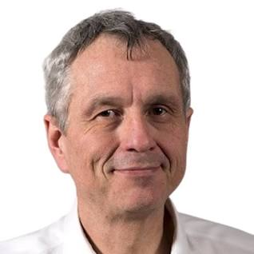
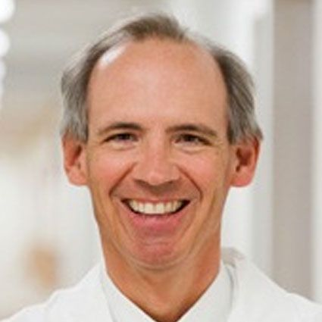
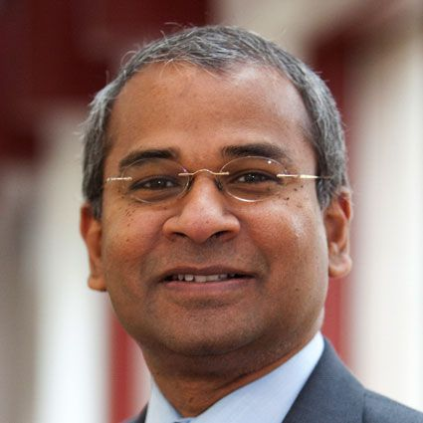
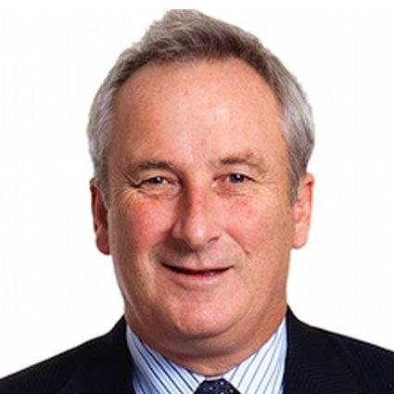
IPITA Presidents No. 13-16
Thierry Berney
2017-2019
James F. Markmann
2019-2021
#6-2003
Raja Kandaswamy
2021-2023
Tom Kay
2023-2025

Slide 16
1st IPITA Council (1993-1995)
President: CG Groth
President-Elect: DER Sutherland
Secretary: R van Schilfgaarde
Treasurer: RV Rajotte
Councilors: R Alejandro, JM Dubernard, DWR Gray, G Pozza, DW Scharp

Slide 17
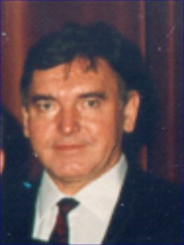
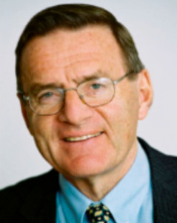
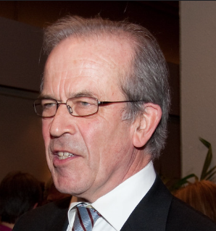
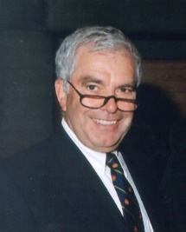
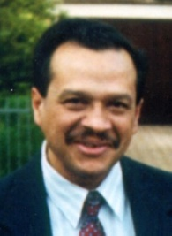
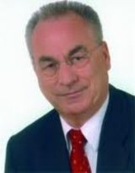
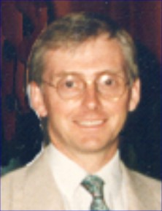
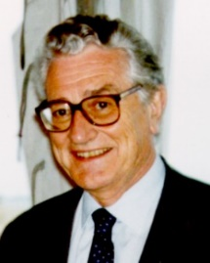
2nd IPITA Council (1995-1997)
President: DER Sutherland
Vice President: JM Dubernard
Immediate Past-President: CG Groth
Secretary: R van Schilfgaarde
Treasurer: RV Rajotte
Councilors: R Alejandro, RG Bretzel, DWR Gray, HW Sollinger, G Pozza

Slide 18
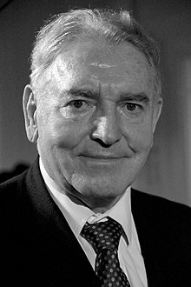
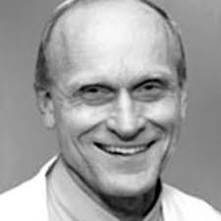
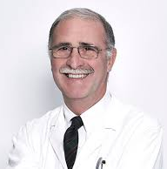
3rd IPITA Council (1997-1999)
President: JM Dubernard
President-Elect: C Ricordi
Immediate Past-President: DER Sutherland
Secretary: R van Schilfgaarde
Treasurer: RV Rajotte
Councilors: ST Bartlett, RG Bretzel, A Secchi, HW Sollinger, B Tuch

Slide 19
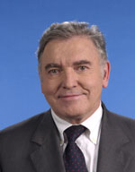
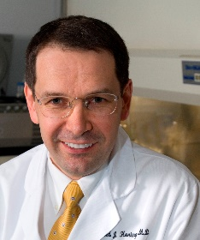
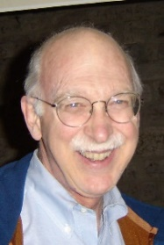
4th IPITA Council (1999-2001)
President: C Ricordi
President-Elect: R van Schilfgaarde
Immediate Past-President: JM Dubernard
Secretary: DWR Gray
Treasurer: RV Rajotte
Councilors: ST Bartlett, BJ Hering, A Secchi, B Tuch, G Weir

Slide 20
5th IPITA Council (2001-2003)
President: R van Schilfgaarde (stepped down after 1 yr)
President-Elect: A Secchi
Immediate Past-President: C Ricordi
Secretary: DWR Gray
Treasurer: RV Rajotte
Councilors: Steven Bartlett, BJ Hering, B Tuch, G. Weir

Slide 21
6th IPITA Council (2003-2005)
President: A Secchi
President-Elect: AMJ Shapiro
Immediate Past-President: R van Schilfgaarde
Secretary: DWR Gray
Treasurer: RV Rajotte

Slide 22
7th IPITA Council (2005-2007)
President: AMJ Shapiro
President-Elect: RG Bretzel
Immediate Past-President: A Secchi
Secretary: DRW Gray
Treasurer: RV Rajotte

Slide 23
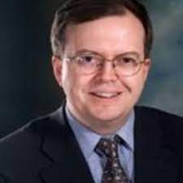
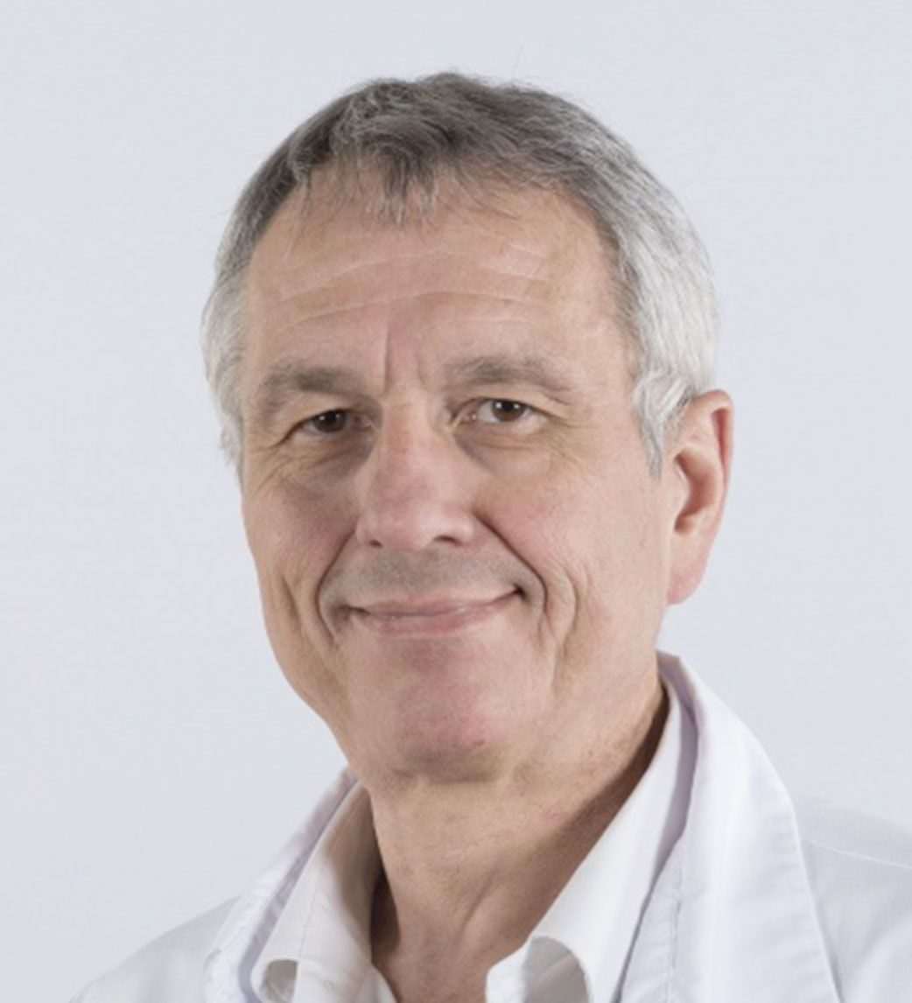
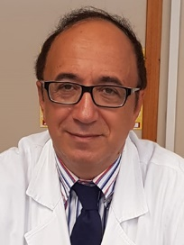
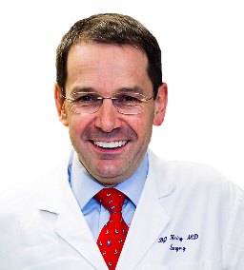
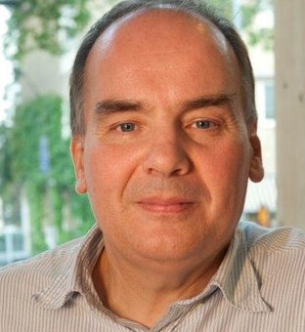
8th IPITA Council (2007-2009)
President: RG Bretzel
President-Elect: ST Bartlett
Immediate Past-President: AM James Shapiro
Secretary: PRV Johnson
Treasurer: RV Rajotte
Councilors: T Berney, R Calafiore, BJ Hering, O Korsgren, J Odorico

Slide 24
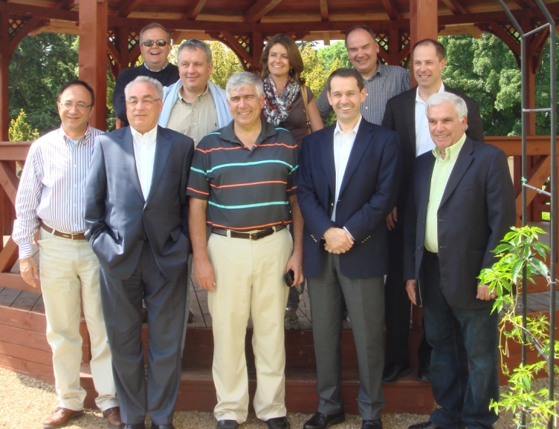
9th IPITA Council (2009-2011)
President: ST Bartlett
President-Elect: PRV Johnson
Immediate Past-President: RG Bretzel
Secretary: JS Odorico
Treasurer: RV Rajotte
Councilors: T Berney, R Calafiore, BJ Hering, O Korsgren, P Maffi

Slide 25
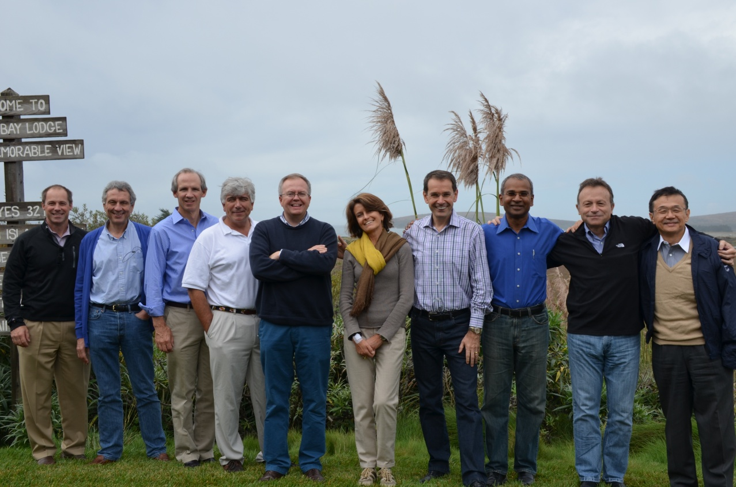
10th IPITA Council (2011-2013)
President: PRV Johnson
Vice President: BJ Hering
Immediate Past-President: ST Bartlett
Secretary: JS Odorico
Treasurer: T Berney
Councilors: M Gotoh, R Kandaswamy, P Maffi, JF Markmann, P Stock
Bodega Bay, CA
2013

Slide 26
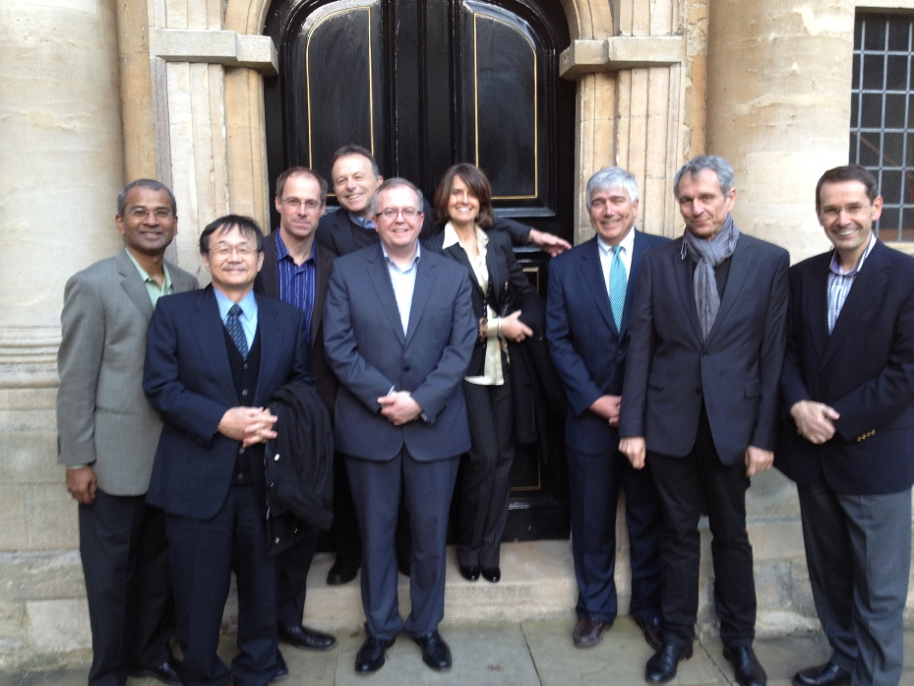
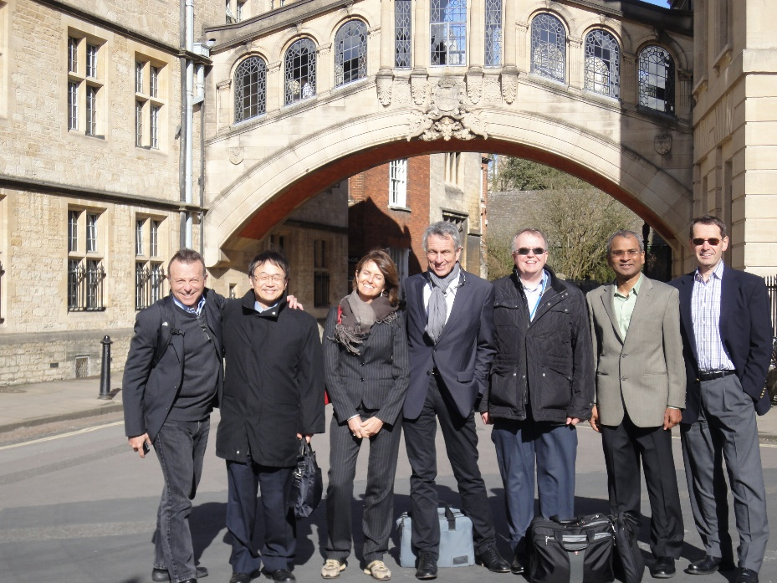
10th IPITA Council (2011-2013)
Oxford, UK - 2013

Slide 27
11th IPITA Council (2013-2015)
President: BJ Hering
President-Elect: JS Odorico
Immediate Past-President: PRV Johnson
Secretary: JF Markmann
Treasurer: T Berney
Councilors: M Gotoh, R Kandaswamy, T Kay, B Ludwig, P Stock

Slide 28
11th & 12th IPITA Council in Australia 2015
Council Retreat – Flinders, Victoria, Australia - 2015

Slide 29
12th IPITA Council (2015-2017)
President: JS Odorico
President-Elect: T Berney
Immediate Past-President: BJ Hering
Secretary: JF Markmann
Treasurer: R Kandaswamy
Councilors: T Kay, T Kenmochi, B Ludwig, L Piemonti, M Rickels
Ex-Officio PRV Johnson

Slide 30
IPITA Council Meeting – Cotswolds, UK - 2017

Slide 31
13th IPITA Council (2017-2019)
President: T Berney
President-Elect: JF Markmann
Immediate Past-President: JS Odorico
Secretary: T Kay
Treasurer: R Kandaswamy
Councilors: M Cooper, DJ Han, L Piemonti, M Rickels, H Scholz
Ex Officio: X Martin, S Cross

Slide 32
14th IPITA Council (2019-2021)
President: JF Markmann
President-Elect: R Kandaswamy
Immediate Past-President: T Berney
Secretary: T Kay
Treasurer: L Piemonti
Councilors: M Cooper, DJ Han, G Orlando, M Rickels, H Scholz
Ex-Officio: J S Odorico

Slide 33
15th IPITA Council (2021-2023)
President: R Kandaswamy
President-Elect: Tom Kay
Immediate Past-President: JF Markmann
Secretary: H Scholz
Treasurer: L Piemonti
Councilors: M Bellin, E De Koning, G Orlando, S Paraskevas, M Perosa de Miranda
Ex-Officio M. Cooper, M. Rickels

Slide 34
IPITA World Congresses and Congress Presidents
1988 Stockholm, Sweden – Carl-Gustav Groth
1989 Minneapolis, MN, USA – David E. R. Sutherland
1991 Lyon, France – Jean-Michel Dubernard
1993 Amsterdam, The Netherlands – Reinout van Schilfgaarde (IPITA was officially founded)
1995 Miami, FL, USA – Camillo Ricordi
1997 Milan – Italy – Guido Pozza and Antonio Secchi
1999 Sydney, Australia – Jeremy Chapman
2001 Innsbruck, Austria – Raimund Margreiter
2003 Dublin, Ireland – David Hickey
2005 Geneva, Switzerland – Philip Morel and Thierry Berney

Slide 35
IPITA World Congresses & Congress Presidents (Cont’d)
11. 2007 Minneapolis, MN, USA – Bernhard J. Hering Joint IPITA-IXA-CTS Congress
12. 2009 Venice, Italy – Emanuele Cozzi IPITA-IXA Joint Congress
13. 2011 Prague, Czech Republic – Frantisek Saudek
14. 2013 Monterey, CA, USA – Peter G. Stock
15. 2015 Melbourne, Australia – Tom Kay
16. 2017 Oxford, UK – Paul RV Johnson
17. 2019 Lyon, France – X Martin and T Berney
18. 2021 Virtual – James F Markmann
19. 2023 San Diego, CA – Raja Kandaswamy Joint IPITA-IXA-CTRMS Congress

Slide 36
1st Joint Conference of IPITA, IXA, and CTS attended by 850 delegates from 25 countries
Executive Board: James Shapiro, Bernhard Hering, Megan Sykes, Jacques Tremblay, and David Sutherland

Slide 37
10th IPITA World Congress – Geneva, CH - 2005

Slide 40
Dr. Paul E. Lacy Lectures
Camillo Ricordi
2005
Clyde F. Barker
2007
Ray Rajotte
2009
Daniel Pipeleers
2011
Ali Naji
2013
Konrad Federlin, Guido Pozza
2015

Slide 41
Dr. Paul E. Lacy Lectures
Garth L. Warnock
2017
Antonio Secchi
2019
A.M. James Shapiro
2021
Bernhard J. Hering
2023

Slide 42
Dr. Richard C. Lillehei Lectures
David Sutherland
2011
Jean-Michel Dubernard
2013
Hans Sollinger
2015
Raimund Margreiter
2017
Angelika & Rainer Gruessner
2019
Robert Stratta
2021

Slide 43
Dr. Richard C. Lillehei Lectures
Richard C. Lillehei Memorial Lecture 2023
Stephen T. Bartlett OSF Healthcare, United States
A legacy of Scientific Discovery

Slide 44
Additional Initiatives

Slide 45
Previous Summits
1st IPITA/HSCI/JDRF Summit – Boston, MA, USA – September 18-20, 2016
2nd IPITA/HSCI/JDRF Summit – Boston, MA, USA – May 7-8, 2018
3rd IPITA/HSCI/JDRF Summit – Virtual – November 2-3, 2020
4th IPITA/HSCI/JDRF Summit – Cambridge, MA, USA – April 24-25, 2023

Slide 46
1st KOL Meeting on Stem Cell Derived Beta Cells

Slide 47
Since its inauguration in Monterey 2013 by Peter Stock, the daily morning run has become a valued tradition and provides an opportunity to shake out your legs before starting a long conference day and meeting fellow conference attendees in a fun and friendly atmosphere.
Here shown are runners who enjoyed the beautiful sights of Lyon in 2019 as local YI, Julien Branchereau led the group on different scenic routes.

Slide 52
IPITA’s 25th Anniversary Celebration
IPITA celebrated its 25th anniversary at the 14th World Congress of the International Pancreas and Islet Transplant Association (IPITA 2013) held in Monterey, California on September 24-27, 2013.
A celebration was held for the Founding Members who were in attendance.
LEFT TO RIGHT:
Drs. Yohici Yasumami, David Sutherland, Max Dubernard, Rodolfo Alejandro, Ray Rajotte, David Scharp

Slide 53
IPITA’s Inaugural Senior Advisory Committee
The IPITA Council suggested in Prague in 2011 a Senior Advisory Committee (SAC) be established. Dr. Rajotte agreed to chair the committee. The SAC was approved at the 2013 IPITA business meeting held at its congress in Monterey, CA.
Ray Rajotte

Slide 54
More Historic Pictures to Come - Islets

Slide 55
Dr. John S. Najarian

Slide 56
Pioneers in Pancreas Transplantation
RC Lillehei
DER Sutherland
FC Goetz
JM Dubernard
J Traeger
V di Carlo and G Pozza
HW Sollinger
RJ Stratta
DB Kaufman
JA Fridell
JS Odorico
ST Bartlett
KL Brayman
RWG Gruessner
AC Gruessner
R Kandaswamy
PS Stock
GW Burke
M Mauer
RP Robertson
CG Groth
R Margreiter
W Land
JP Squifflet
PJ Friend
RD Allen
JR Chapman

Slide 59
END

